Slide 1
Bail Reform in Maryland
Meshal Alkhowaiter, Doug Hummel-Price, Caroline Reppert, Alyssa Snider
Notes:
Who are we: Representatives from the AG’s office (Brian Frosh - D)
Who we are presenting to: MD Governor Larry Hogan ®
Time Breakdown- first third - 7 minutes
Second third- 5 minutes
Last third- 8 minutes

Slide 2
Recommendation Overview
Call for legislation to abolish monetary bail
Replace with risk assessment model
Mandate state funding for expanded pretrial services
Notes:
(Doug)

Slide 3
Background: What is Bail?
Presumptive Innocence
Bail vs bond
General problems with bail
Notes:
(Doug)

Slide 4
The Three Waves of Bail Reform
Wave I: The Bail Reform Act of 1966 and “Presumptive Release”
Wave II: The Bail Reform Act of 1984 and “Dangerousness”
Wave III: Modern Day Reform Efforts
  Maryland Court of Appeals decision
Notes:
(Doug) transition to (Alyssa) for the 4th bullet point.

Slide 5
Stakeholders: Key Players and Political Considerations
Maryland Court of Appeals Rules Committee - most immediate power
Maryland Legislature - broadest power
Bail Bond Agencies - most to lose
Pro-reform interest groups
Judges
Maryland Attorney General Brian Frosh and Prosecutors
Notes:
(Alyssa)

Slide 6
Alternatives: Washington, D.C.
Oldest risk assessment model in United States
Individuals’ risk scores based on algorithm and personal information
  Two scores: safety and appearance risks
Effectiveness:
  89% trial appearance rate
  91% of released defendants did not violate release conditions
Problems:
  Model has high false positive rate.
Notes:
(Meshal)
In 2015 alone, the District’s Pretrial Service Agency estimates that it saved $200 per day, for each of the 2650 defendants released before trial. The PSA further states it would have cost taxpayers in the city a minimum of $398 million a year, had the released defendants spent their pretrial days in prison.
*The model is reviewed annually by a 3rd party, Urban Institute, and ongoing recommendations are made each year.

Slide 7
Alternatives: Pittsburgh, Pennsylvania
Risk assessment model
Effectiveness:
  80% of released defendants report to hearings
  79% of released defendants do not reoffend
  18% reduction in county jail bookings
Problems:
  Biased algorithm
  Judges highly autonomous
Notes:
(Caroline)
History:
Started in 2007 after the publication of a national report that showed the issues in Pittsburgh’s pretrial bail system
Used a risk assessment model
In-person interview and background check
Low-risk- released on recognizance, or released with low supervision (phone check-ins or in-person check-ins)
Medium-risk- report in person to a pre-trial services agency and could be subject to electronic monitoring
High-risk- typically not recommended for release (sometimes released with GPS monitoring)
See table for exact amounts
60% of defendants are eligable for release through pretrial services
Successful model overall (see stats)
Judges like model because it gives them a better insight into background of the defendant/circumstances of the crime
Problems:
Racially biased algorithm because based on previous criminal records (Doug talking about more later)
Assessments are just suggestions to judges-
Elections of judges are really important because if judge isn’t into bail reform, can still assign monetary bail or jail a person until trial even if they don’t deserve it

Slide 8
Alternatives: New Jersey
First statewide bail reform initiative
Public Safety Assessment
Mental health and addiction services
Effectiveness:
  20% decrease in defendants imprisoned during pretrial
Problems:
  Funding
Notes:
(Caroline)
Background:
Started in 2014 after a ballot initiative won 62% of the vote
First state-wide initiative
Officially began in 2017
Risk assessment model
Call is a “Public Safety Assessment”
2 scores (1-6 scale)
Flight risk
Risk they will reoffend while released
True focus on rehabilitation- offer mental health and addiction services if judge deems appropriate as a part of reporting
Successful- see stats
Problems
Same as Pittsburgh (bias algorithm and judge autonomy)
Funded through court fees
NOT through state budget-
Makes programs unsustainable

Slide 9
Alternatives: California
First state to fully abolish monetary bail system
Highest median bail amount nationwide
67% of LA County’s jail population were pending their trial
25% of monetary bail amounts fell on the homeless
Notes:
(Meshal)
* Houseless Persons are defined as those recorded as “transient” in LAPD data and those who, upon arrest, provide the address of a shelter as their home residence.

Slide 10
Recommendation
Legislation replacing monetary bail with risk assessment model
  Assists judges in determining release conditions
Expanded pretrial services funded through state budget
Increasing public confidence in the model:
  Minimize potential bias
  Maximize transparency
  Maintain due process
Notes:
(Doug)

Slide 11
Increasing Public Confidence in the Model
Minimizing Bias
  A model is only strong as its data
Notes:
(Doug)

Slide 12

An Analogy: Cat-Dog Assessment Models
Notes:
(Doug)

Slide 13
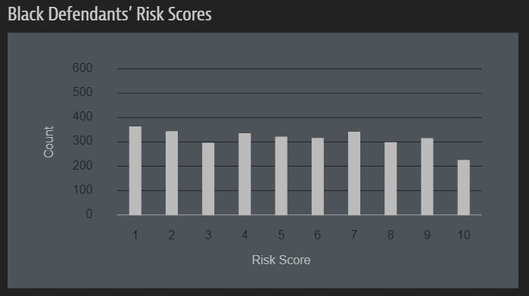
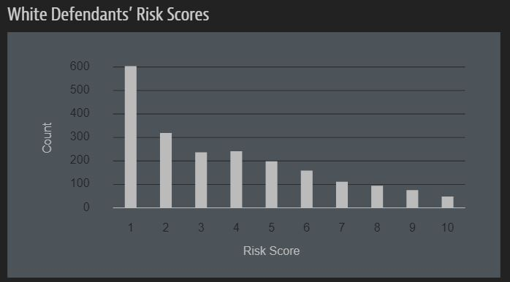
Example of Bias: Broward County, FL
Notes:
(Doug)

Slide 14
Increasing Public Confidence in the Model
Minimizing Bias
  A model is only strong as its data
  Data team must reflect the demographics of Maryland
  Acknowledging limitations up front
  Giving judges discretion to overrule the algorithm
    Only in the direction of release
Notes:
(Doug) The algorithmn is already erring on the side of harsher sentences

Slide 15
Increasing Public Confidence in the Model
Maximizing Transparency
  Public-private partnership
  Data and algorithm must be accessible
  Yearly report and independent validation
Ensuring Due process
  Public hearings
  Right to appeal
  Alternative methods of ensuring attendance
Notes:
(Doug)

Slide 16
Cost-Benefit Analysis
Detention: $83-$153 / person / day
Pretrial services: $7-$25 / person / day
The costs of bail to families: $51 million+ / year (2011-2015)
The costs of detention to communities
Minimal revenue loss from abolishing monetary bail
Notes:
(Alyssa)

Slide 17
Final Thoughts
Call for legislation that abolishes monetary bail
Replace with risk assessment model with caveats mentioned
Mandate funding for Pretrial Services through state budget

Slide 18
Questions?

Slide 19
Additional Information: Charts & Tables
How do D.C.’s Risk Algorithm Recommendations Appear to a Judge?
Low | Release on personal recognizance
Condition Monitoring | Release on personal recognizance with conditions not intended to be restrictive of liberty (e.g., surrender of passport)
Moderate | Release under more restrictive conditions, such as mandatory drug or alcohol testing or treatment (if appropriate), curfew, or personal reporting to PSA
High | Release under only the most restrictive conditions (e.g., Intensive Supervision Program, Heightened Supervision Program, house arrest, halfway house placement)
Severe | Recommend detention (or a hold) under most circumstances

Slide 20
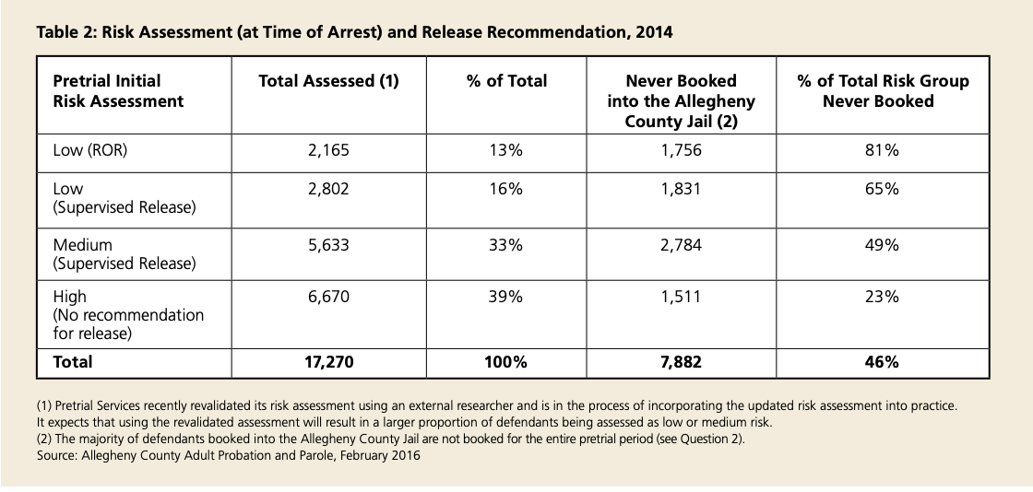
Additional Information: Pittsburgh, PA
Notes:
(Caroline)

Slide 21
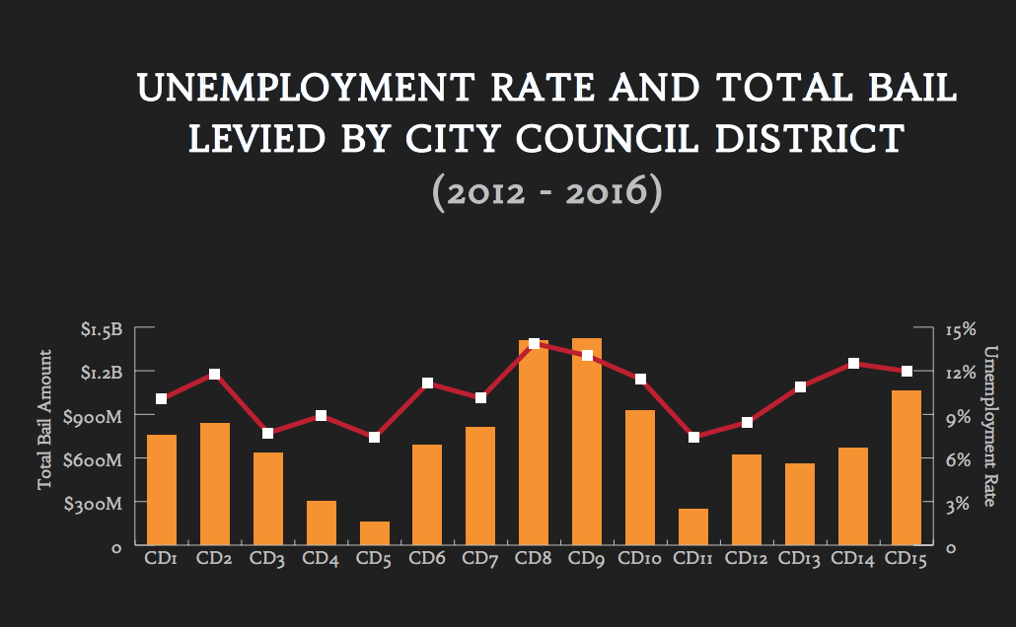
Additional Information: Cost Analysis

